Slide 1
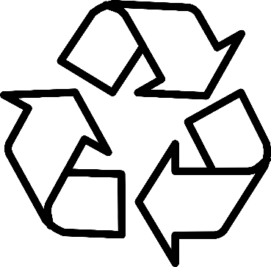
Recycling Aid
By Andrew Casey, Saadat Emilbekova, Dylan Jablonski, Jason Mele & Will Zakroff

Slide 2


Project Overview
What is the goal of our project?
Help people learn how to properly recycle by teaching people what each recycling material is and how you would recycle that material.
Why is our project socially relevant?
Our project is socially relevant due to it addressing the issues of pollution and waste, particularly due to the problem of improper recycling. Teaching people to correctly recycle, could lead to less waste and pollution as a whole.
What are the requirements (functionality) of your project?
Our functionality of our project was teaching recycling by letting users look up materials, calculate impact, play a recycling game, and simulate recycling behavior with different settings.

Slide 3
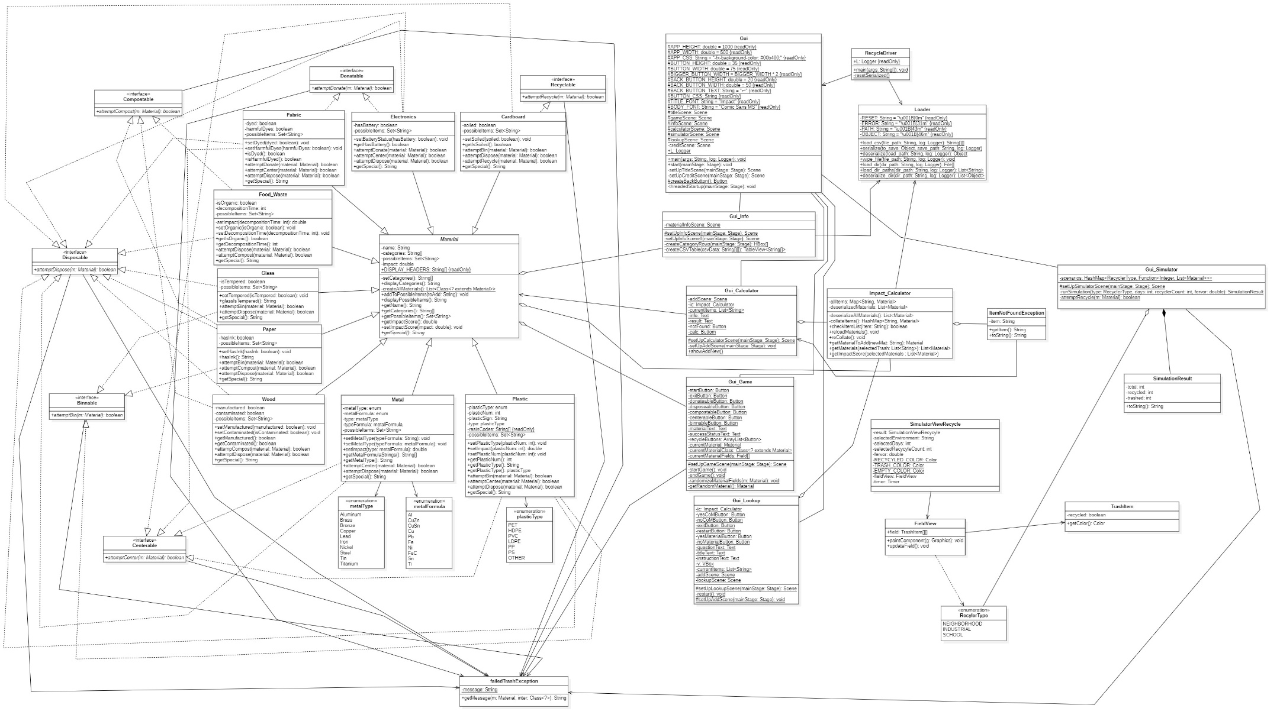
UML Class

Slide 4
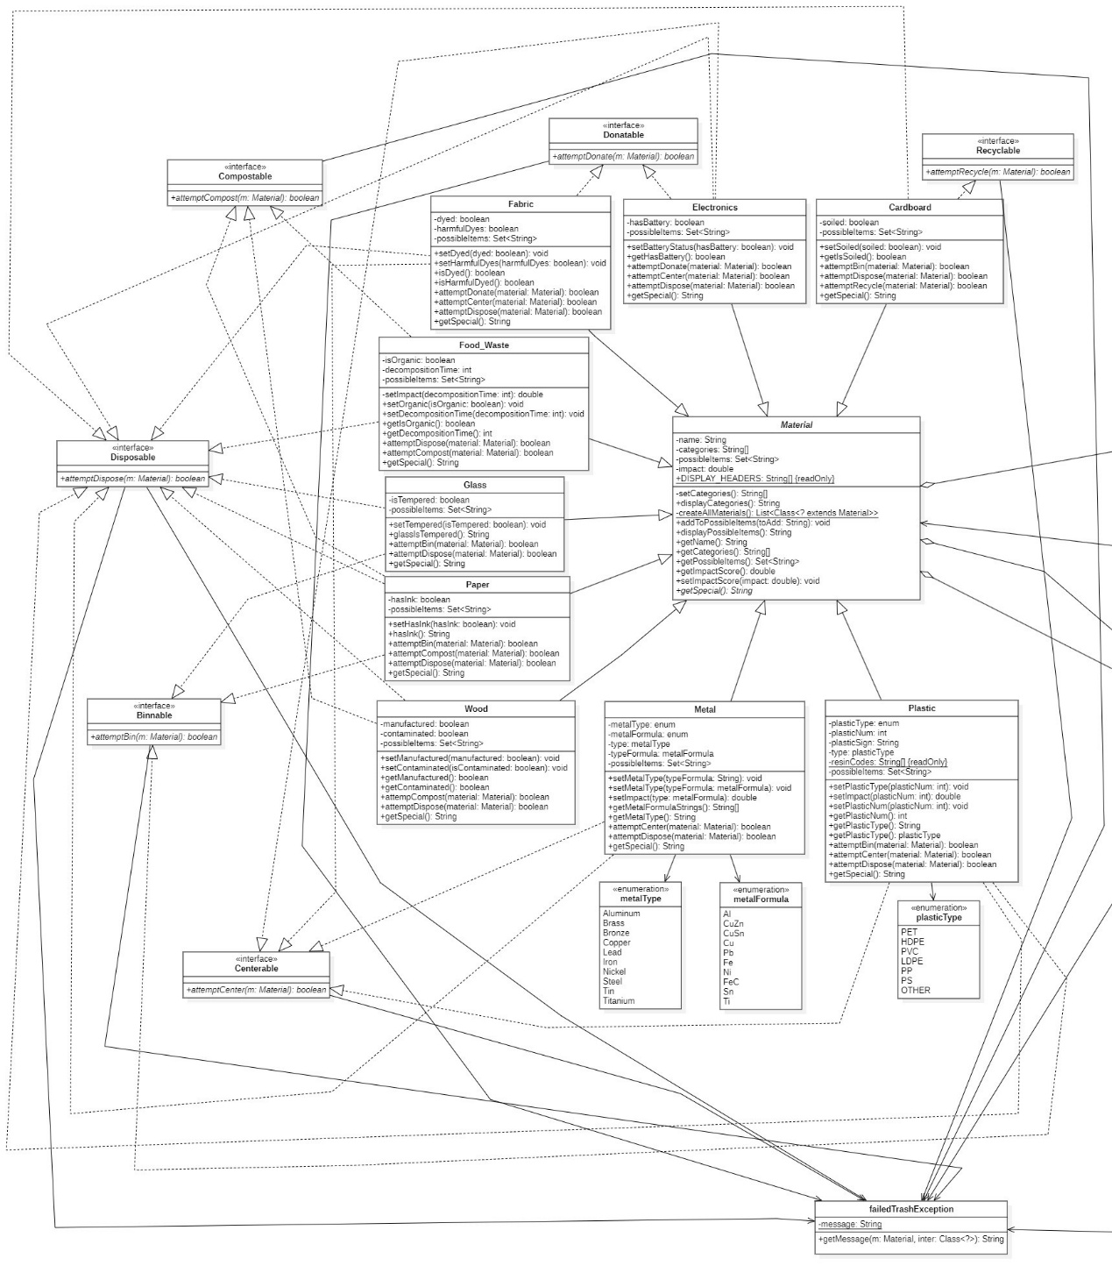
UML Class Diagram Class and Interfaces

Slide 5
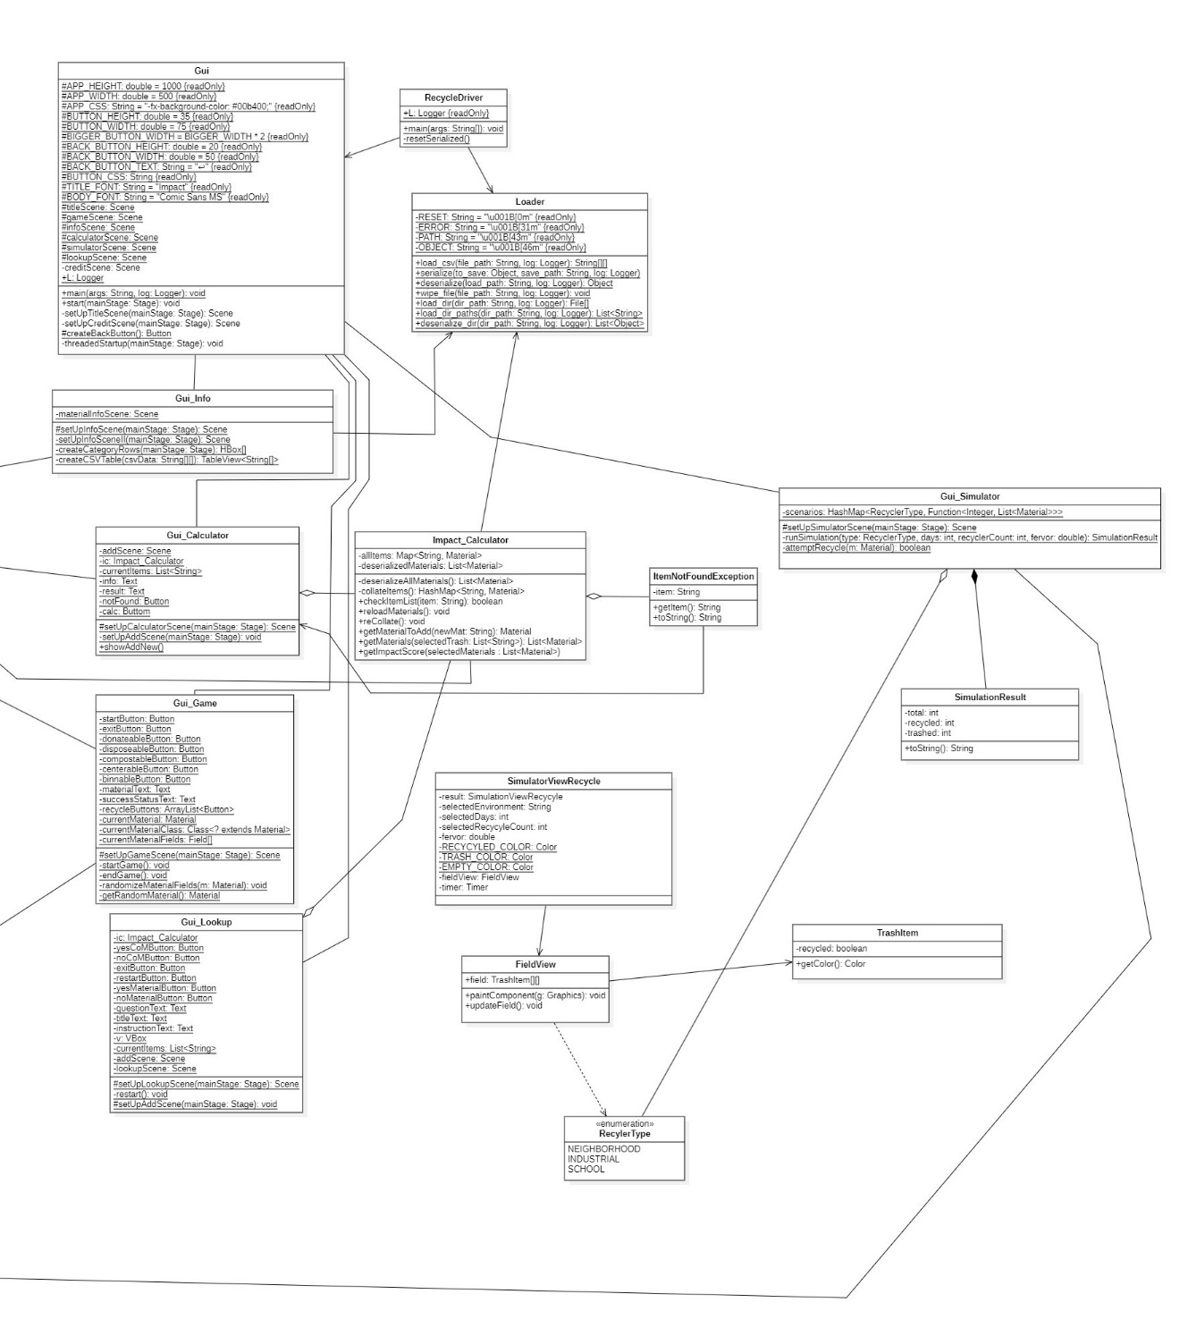
UML Class Diagram Gui

Slide 6
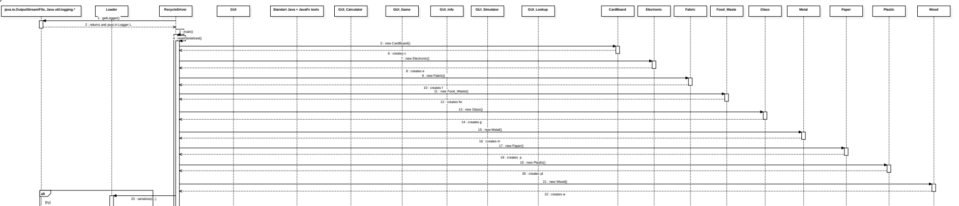
UML Sequence Diagram Part1

Slide 7
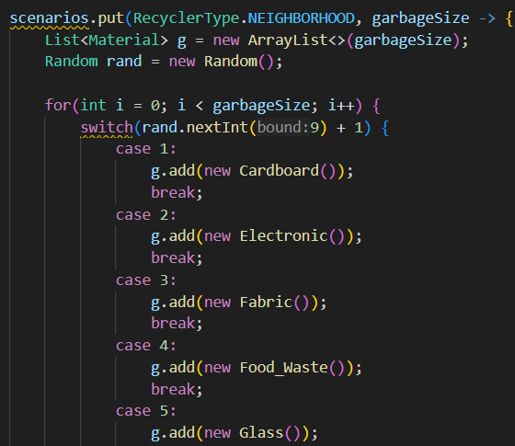
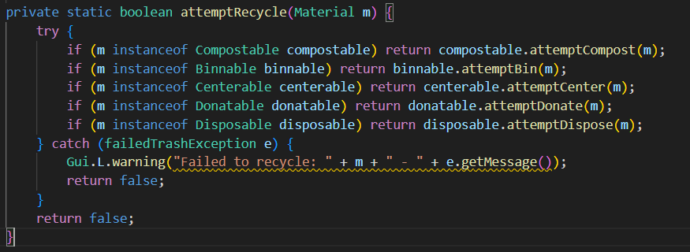
Polymorphic Collections
How did you use them in your application?
We use polymorphic collection in our project by generating random material subclasses like Cardboard and Electronic. Even though they are different classes, they can be treated the same because they inherit from the Material class, which lets us store them together and work with them using shared methods.
How did you avoid coupling to subclasses?
Instead of checking the material’s exact class, we checking if it used an interface like Compostable or Binnable. This allows any material that can compost, bin, and add newer ones later without changing anything. In our project the code only care about what the material can do and not what class it is.
What code demonstrates how you handled different object types?
In our code we have one method called attempt Recycle. Instead of checking exactly what kind of material it is , we checked what the material is able to do like if its compost, donate, and bin. This lets us recycle different materials.

Slide 8
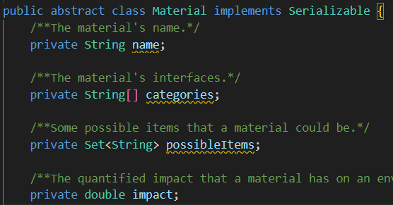
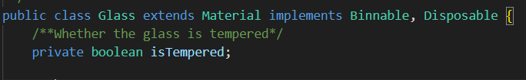
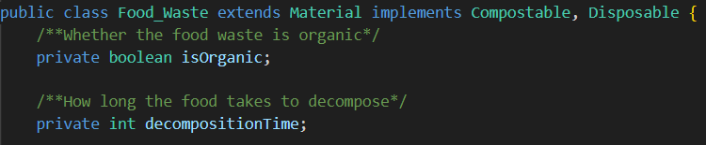
Abstract Classes
Example of Abstract class
Where did you use abstract classes?
We used an abstract class called Material
Why did you use them?
We used the Material class to allow subclass to share common variables and methods for subclass materials, and to prevent anyone from making a generic material object that isn’t specific like Glass or Food Waste
.

Slide 9
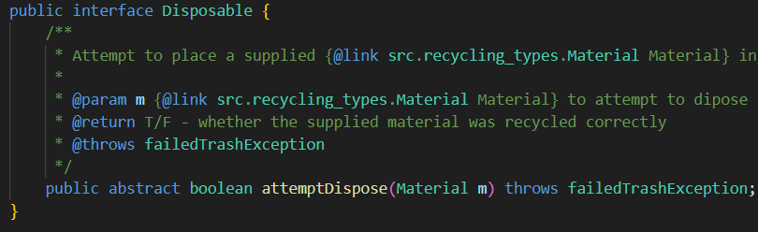
Interfaces
Where were interfaces used?
We had interfaces like Disposable and Compostable and they were used to describe what a material can do. Example: The Food Waste subclass of Material implements Compostable, showing that any Food Waste is compostable.
Did you have to use interfaces for your project?
Yes, we had to use interfaces in our project due to needing to check if something could be composted or disposable without needing to know the exact type of material subclass it is.
What were the advantages/disadvantages of using interfaces?
An advantage of using interfaces is it decoupled the code, where we didn’t need to know what class, a material was, we only needed to know what it could do. A disadvantage is some materials implement many interfaces; this makes them a little more complicated to set up.

Slide 10
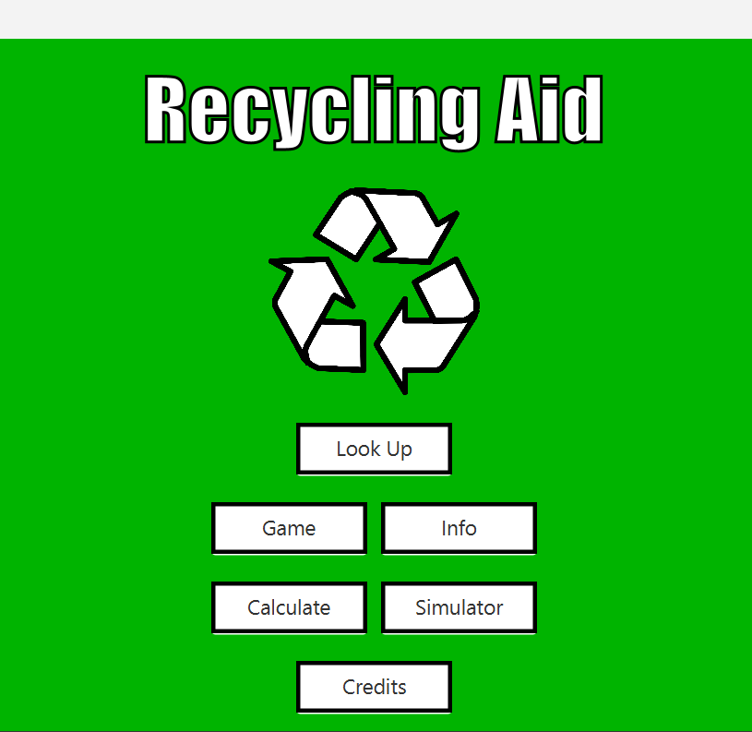
JavaFX GUI
What was the most challenging aspect of your GUI?
The most challenging part of the GUI was trying to manage all of the different user choices a user could pick and updating the screen correctly with proper information and without confusing the user.

Slide 11

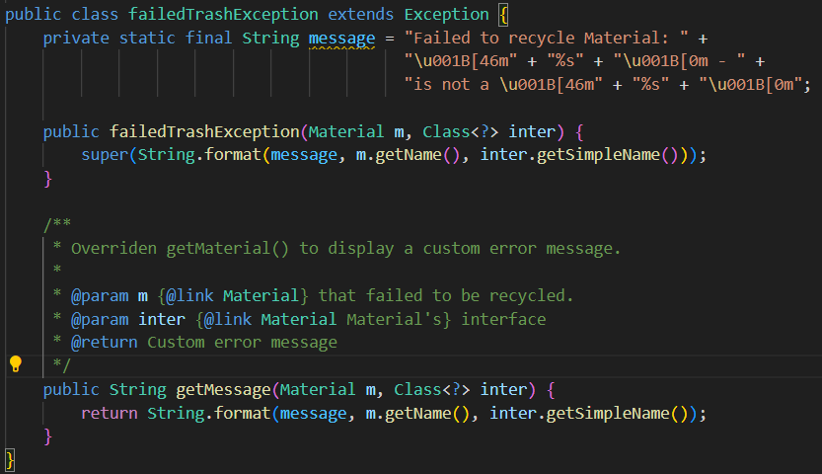
Customized Error Handling
Where did you use it?
We created a custom exception class called failedTrashException and it was used to handle errors when a material failed to be recycled properly.
Did you like using it? Or did you feel it was overkill?
We liked using these exception due to it showing exactly what went wrong.
Custom exception class
Exception being used

Slide 12
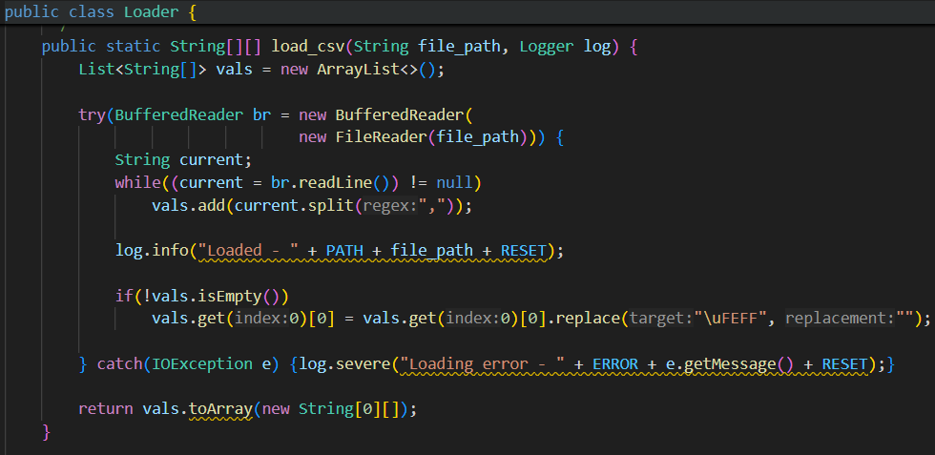
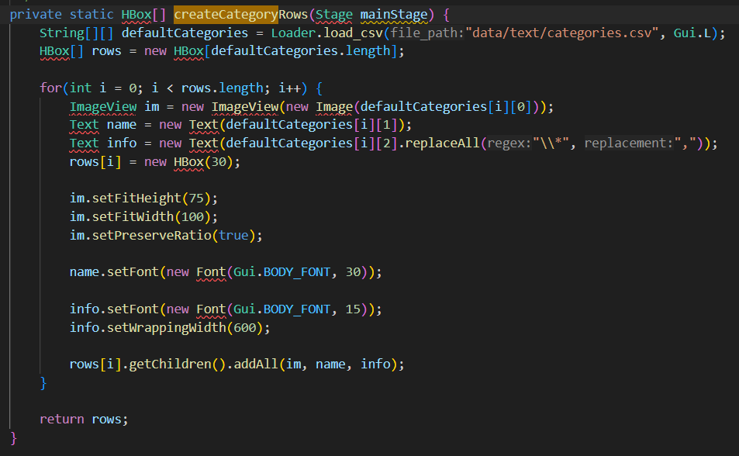
File Input/Output Part1
What were your file input/output strategies?
We used two main files I/O strategies. Loading csv files to material categories and Serialization to save and load java objects
We load csv using the load csv method in the loader and this is used in Gui Lookup to display category data
Explain load_csv() in Loader
Explain Loader being used in Gui_Info

Slide 13
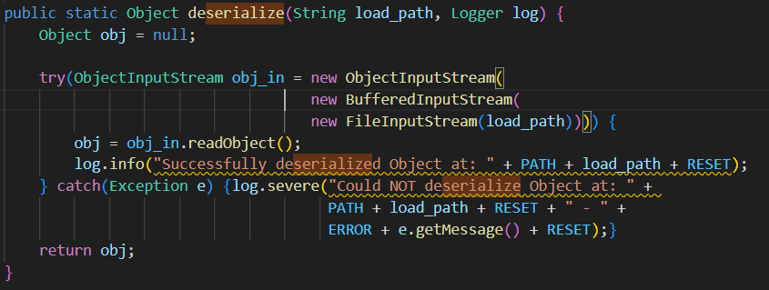
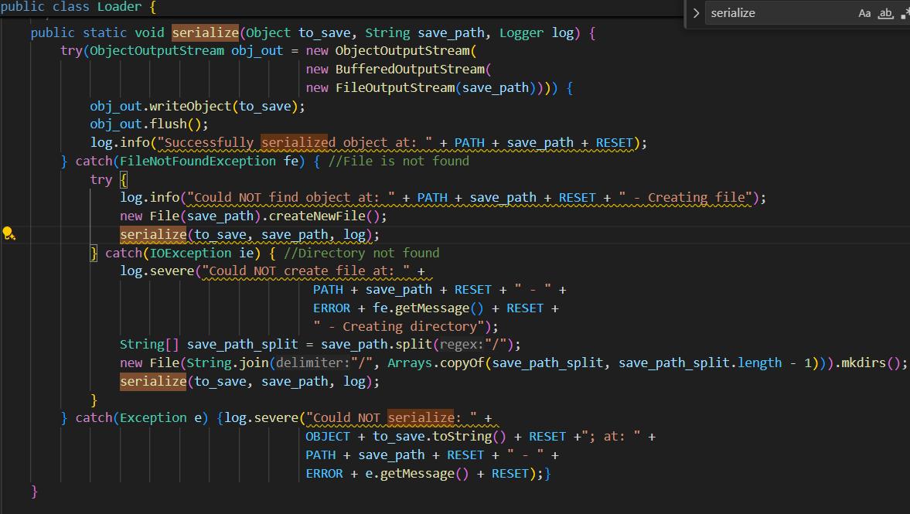
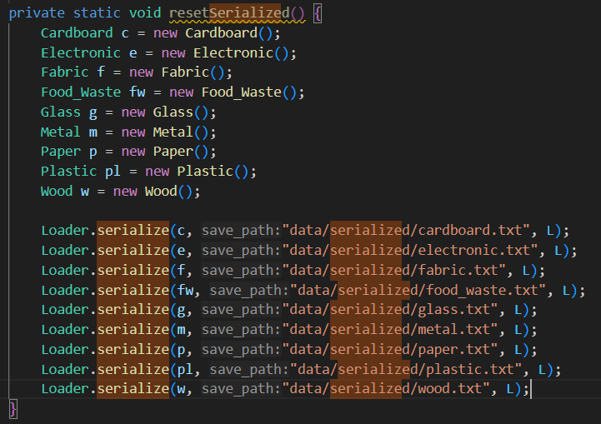
File Input/Output part2
Where did you use serialization?
We used java object serialization to save Material objects like Plastic and Wood into .txt files.
Later reload them without reconstructing manually, which persist data across sessions and quicky restores default materials.
Explain deserialize() in Loader
Explain serialize() in Loader
Explain how Loader uses serialization in RecycleDriviver method

Slide 14

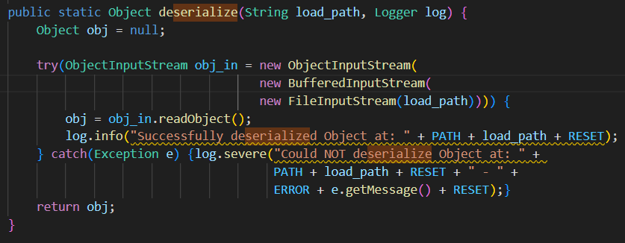
Use of logging
Logging seen first in RecycleDriver
How and where did you use logging?
We created a shared Logger in RecycleDriver and we passed this logger into different parts of the program. We logged important actions like loading csv files, serializing materials, deserializing materials, and resetting files.
Why did you implement this way?
We used logging this way because if something broke we could quickly fix it and we immediately knew what operation failed.
Loggers are pass through the Loader in RecycleDriver so that the Loader can use them when serializing materials
Now that the Loader has the logger it can log info on what is happening during the process allowing us to know what is happening and if any bugs are occurring

Slide 15
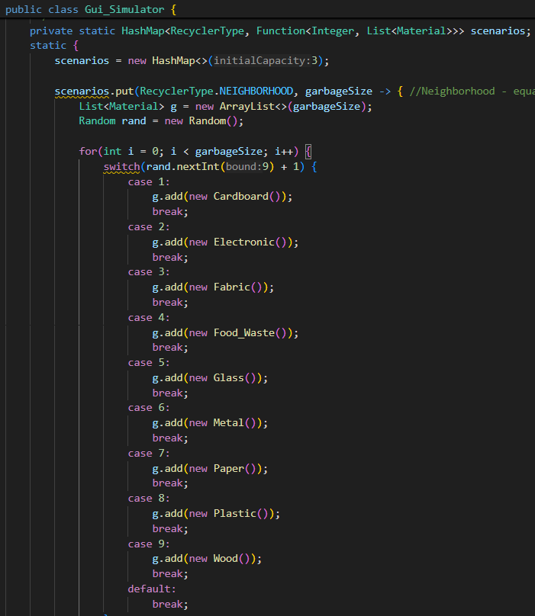
Lambda Expressions (beyond .forEach() and event handling)
Explanation
We use lambda’s in Gui_Simulator, where we use lambdas to define different garbage generations scenarios.
We have a HashMap called scenarios that stores a Recycle Type as its key and a lambda as its value. The lambda creates a list of materials based on a random selection without needing to write separated methods for each scenario. We store behaviors like neighborhood trash direct in a HashMap using a lambda.

Slide 16
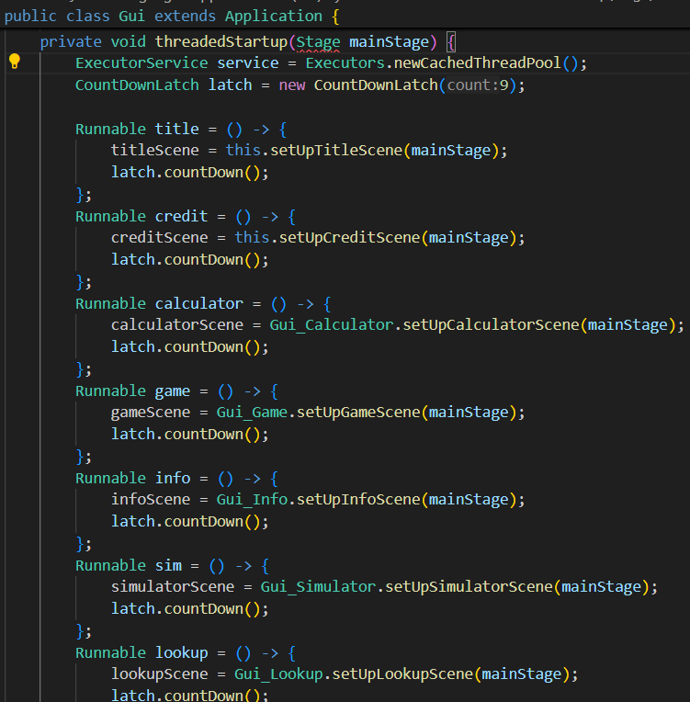
Threads
How did you use multithreading in the project?
In the threadedStartup method we create an ExecutorService which is a thread pool

Slide 17
Team Contributions
Jason: UML, Polymorphic Collections, Abstract class, JavaFX, File I/O, Logging, Threads, and Serialization.
Andrew Casey: Lambdas, Polymorphic Collections, JavaFX and Serialization.
Will Zakroff: Lambdas, Polymorphic Collections, JavaFX and Serialization.
Saadat Emilbekova: Polymorphic Collections, JavaFX, Sequence Diagram,
Dylan Jablonski: Polymorphic Collections, JavaFX, UML

